Slide 1
The Impact of Pandemic Covid-19 to Exchange Rate of Rupiah to Other Currencies
0880810 Samingun Handoyo
0852623 Andreas Rony Wijaya

Slide 2
Introduction
Covid-19 has had an impact in various fields of human life, such as social, education, industry, government, and socio-economy, etc.
In the economic sector, the exchange rate is an indicator of the economic stability of a country
The government has a policy to control the exchange rate
The government is also making efforts to control Covid-19
In fact, many countries have not succeeded in dealing with Covid-19.
Is the exchange rate of a country affected by the addition of positive cases of Covid-19?

Slide 3
Introduction
Prediction of future exchange rates is important in policy making.
How to predict exchange rates using the Autoregressive-Distributed Lag (ARDL) and Long short-term memory (LSTM) methods?
In the time series, the vector autoregressive method is used for forecasting multiple time series data.
whereas in machine learning, LSTM have characteristics similar to ARDL

Slide 4
Goal
Knowing the effect of the ratio number of daily positive confirmed cases between (other country) to Indonesia on the exchange rate
Modeling the exchange rate of the rupiah against several countries' currency values ​​that have a similar case to Indonesia
Measures performance of training model both of ARDL and LSTM
Measures performance of test model both of ARDL and LSTM and decided the best model

Slide 5
Research Method
Preparing Data
Getting data,
Screening data,
Data Exploration
Data Transformation
Test Granger causality among series
Feature engineering
Determine model structure of ARDL
Estimate the parameter model
Model Performance using MAPE, RMSE, R-Squared
Determine model structure of LSTM
Formatting the structure of input-output LSTM
Tuning parameter of training model
Conduct the training of some LSTM model
Model performance using MAPE, RMSE, R-Squared
Selecting the best model using testing data
Discussion

Slide 6
Data Description
The number of daily new cases confirmed positive for Covid-19 in a country, and
The exchange rate of the IDR against related countries
Countries
Indonesia (Asia - Rupiah)
Malaysia (Asia - Ringgit)
Japan (Asia – Yen)
US (North America – Dollar America)
France (Europe – Euro)

Slide 7
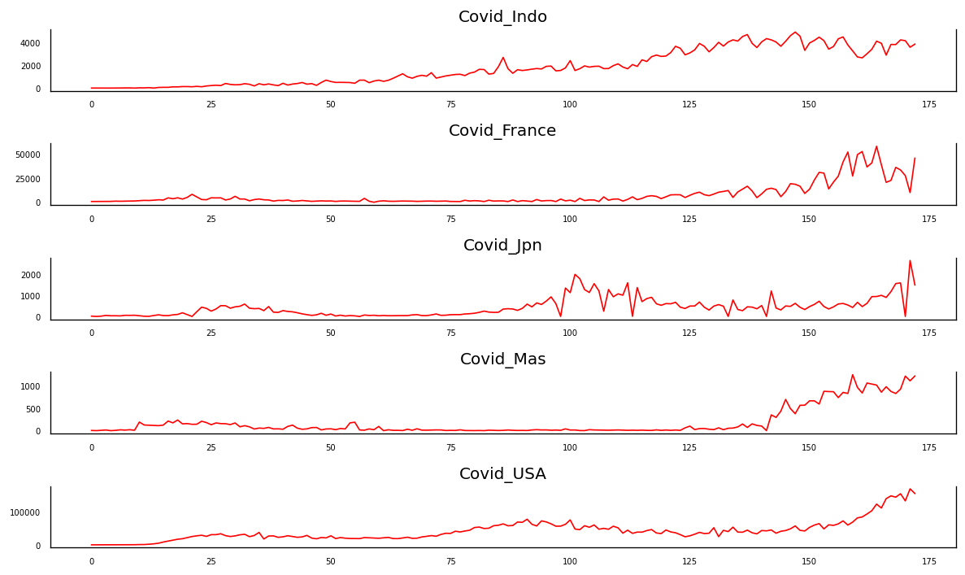
Data Covid-19
Figure 1. Covid-19 From 1 March to 18 December 2020

Slide 8
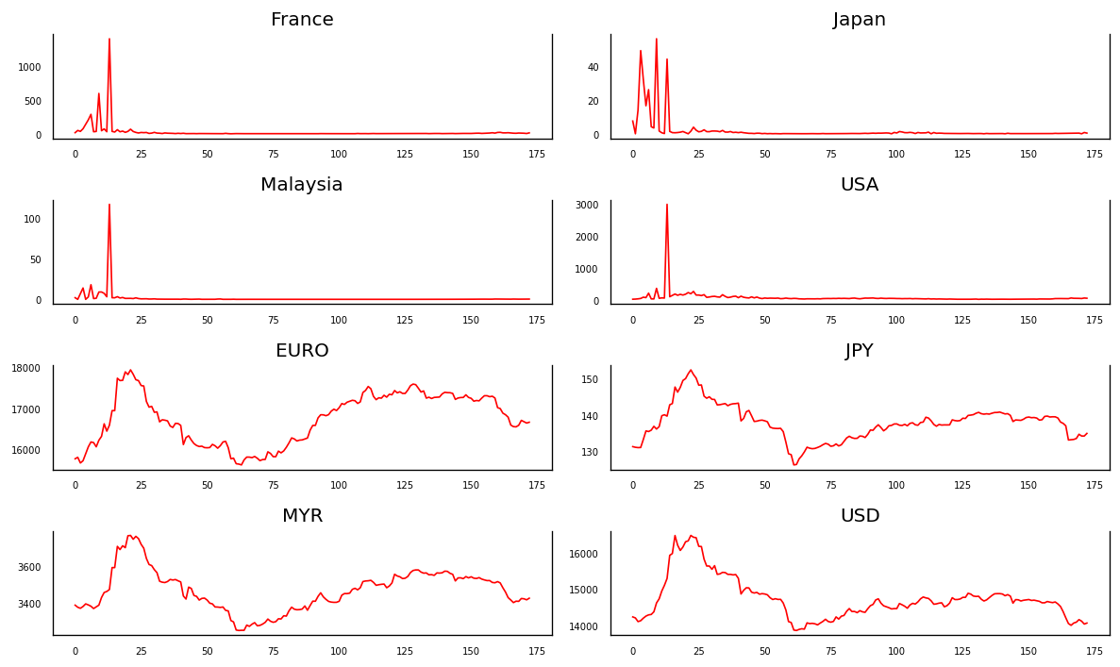
Data Covid-19 Ratio and Exchange Rate
Figure 2. Covid-19 Ratio and Exchange Rate From 1 March to 18 December 2020

Slide 9
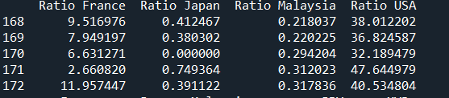
Data Ratio Covid-19
def covid_ratio(data):
n_sample = len(data[:,1])
temp = np.zeros((n_sample,4))
for j in range(4):
for i in range(n_sample):
if data[i,0]==0:
temp[i,j]=data[i,j+1]
else:
temp[i,j]=data[i,j+1]/data[i,0]
return temp

Slide 10
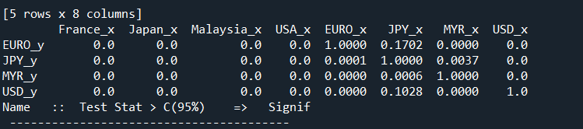

Granger Causality Test
If the value <0.05, the variable in the column has causality to the variable in the row
In sum, the covid-19 ratio have causality effect to all exchange rate

Slide 11
Progress and Further Analysis
We have success to obtain the predictor variable that influence the exchange rate.
We curry out the feature engineering using criteria of AIC, BIC, R-Squared to obtain the optimal predictor variables.
Next step, we will determine the model structure, and assume that there are three lags of each variable that influence to response variable.

